Slide 1
Stealing Momentum from Mars Optimizing the Gravitational Slingshot
Max stronge & ayesha iqbal
Phys 481

Slide 2
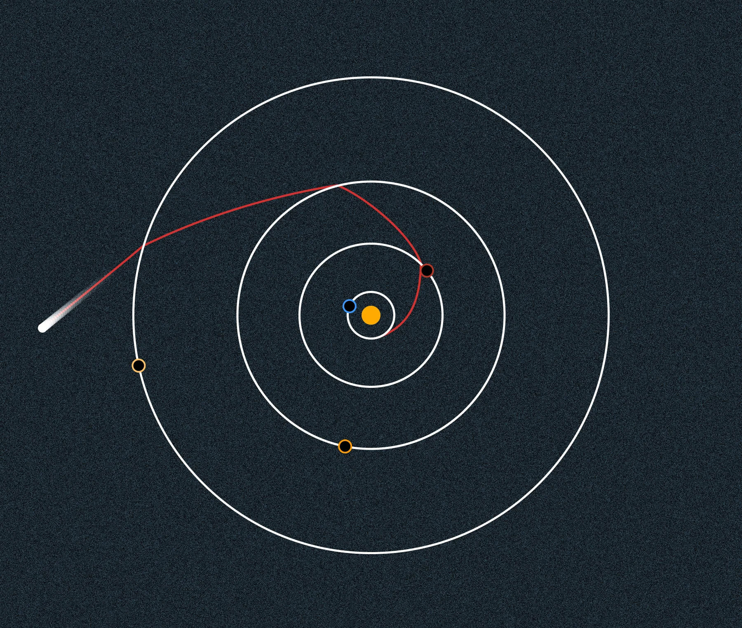
Gravitational Assists:
- a spaceflight maneuver where a spacecraft utilizes another large body (typically a planet) to gain velocity without propellant
- helpful technique for reducing the amount of fuel required, extending spacecraft range, and adjusting mission trajectories
- less fuel needed = big cost savings….helps get missions approved!
- first used in 1959 by the Soviet probe Luna 3 (first time photographing the dark side of our moon)
- crucial part of the Voyager missions

Slide 3
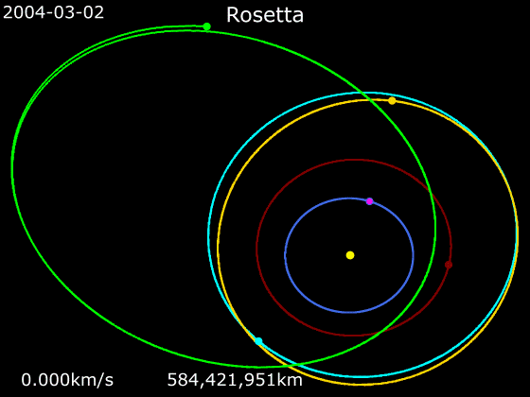

Slide 4
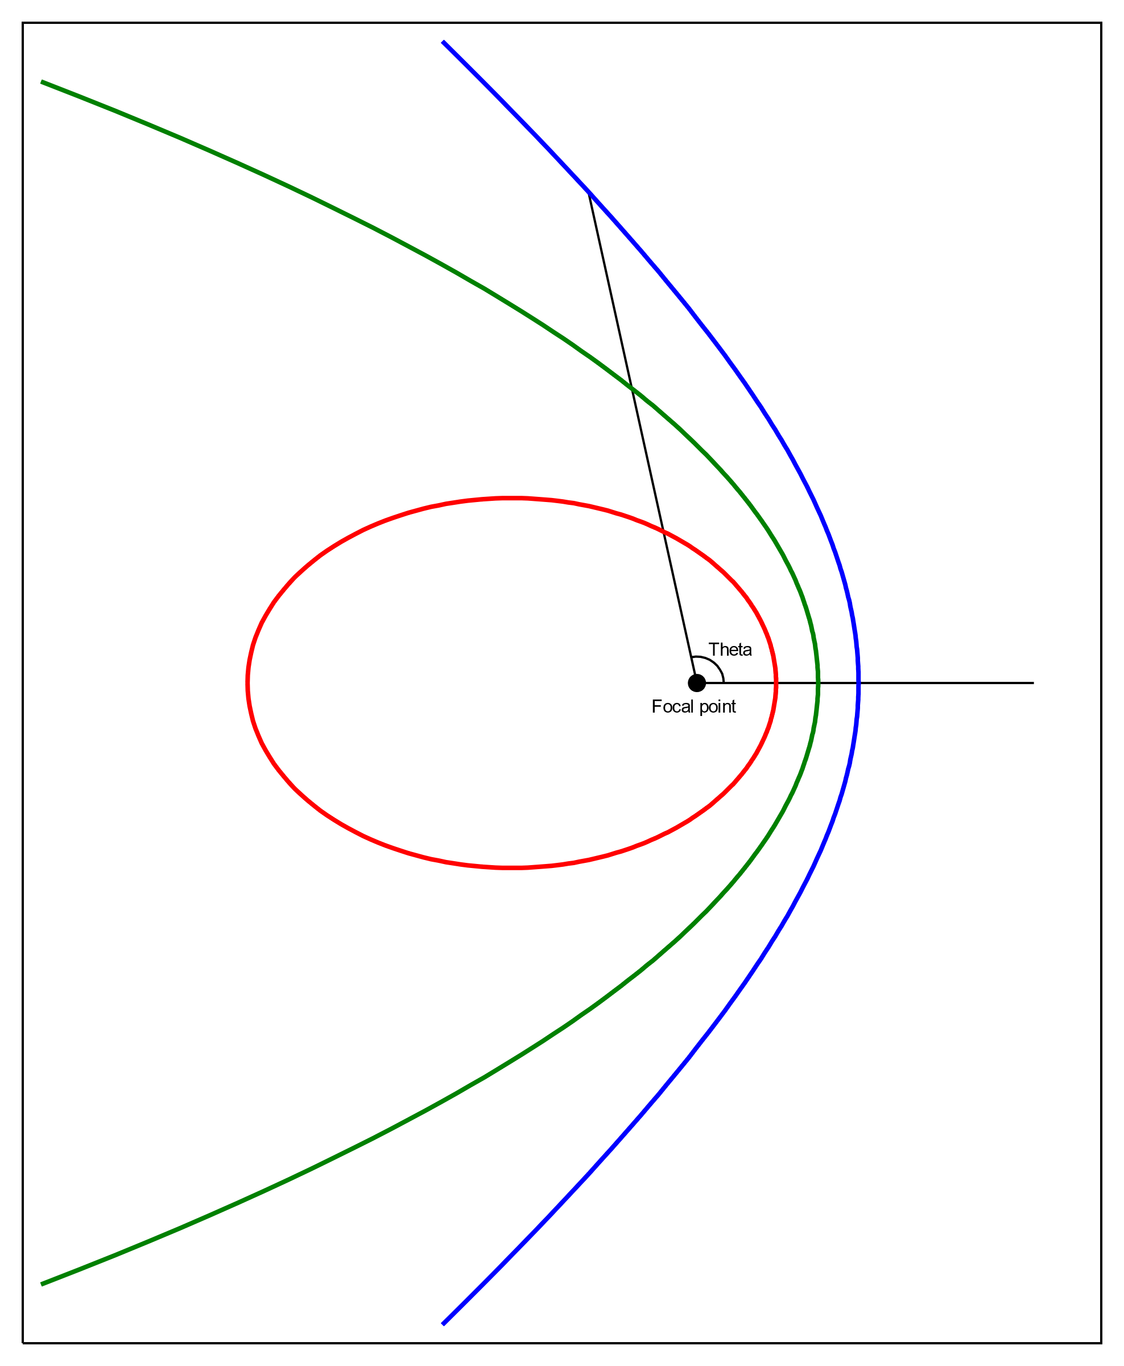
How does this work?
- Remember PHYS343…
- We dealt mostly with stable, bounded orbits – but what about unbounded orbits? (i.e. eccentricity > 1)
- Not usually treated fully in undergrad classical mechanics, but we have seen something similar…
- Pop quiz: what would the orbit look like with eccentricity 0?

Slide 5
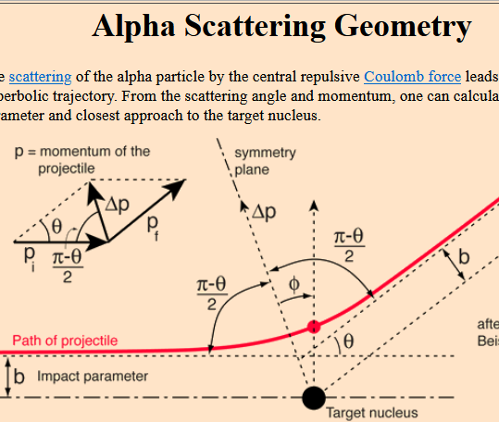
Beyond Rutherford Scattering – Gravity Scattering?
- We’ve seen particle scattering before in PHYS229 (and other courses)
- This is the same problem as the hyperbolic orbit! Only this time, it’s a gravitational interaction instead of an electromagnetic one…
- What do those two forces have in common?
- With this context, we have a better framework for tackling an optimization problem….
- Less fuel = asking for less money, and the more momentum we can steal from a planet, the less we need to generate via impulse…so…

Slide 6
Question:
“What is the maximum possible amount of speed we can gain by performing a gravitational assist maneuver using the planet Mars?“
Let’s set up the problem and then optimize!

Slide 7
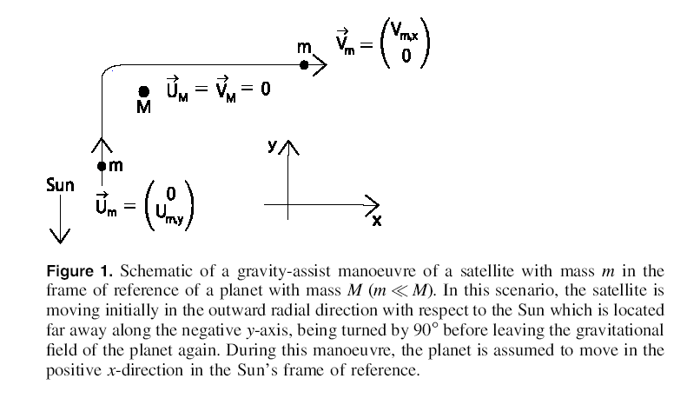
Derivation (speedrun)
We can start by thinking about conservation of energy…
- The image to the right is in the frame of reference of the planet we’re using (Mars!)
- First we’ll look at scattering by exactly 90° (may seem contrived, but we pulled this off with Voyager…)
- Very far away from the planet, the gravitational potential energy will be negligible, so total energy = KE....and same on the other side
- so via conservation of energy, we’ll have exactly the same speed going out as we had coming in, just in a different direction…huh?
- See P Berg 2023 Eur. J. Phys. 44 025002

Slide 8
What’s the point of this maneuver if we didn’t gain any speed? Any theories?

Slide 9
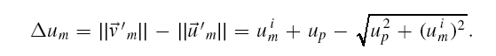
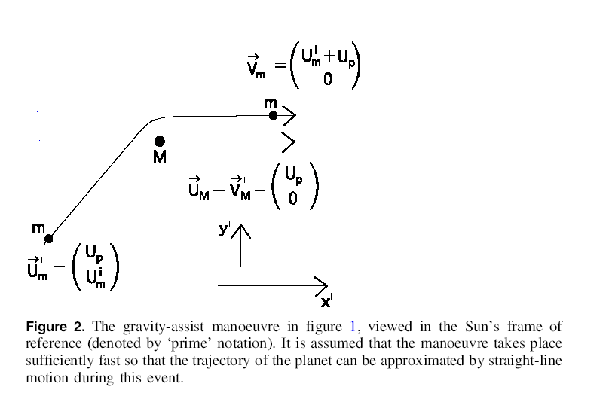
Derivation (speedrun)
- We don’t gain speed in the planet’s frame, but in the heliocentric frame of reference…Mars is moving!
- Key simplifying assumption: the timescale of this maneuver is << the timescale of Mars’ orbit around the sun so….
- …we can approximate the very small section of Mars’ elliptical orbit as just a straight line…
- which means we can just use a simple Galilean transform to add velocities!
- In the heliocentric frame, for right-angle scattering, we’ll get a ‘boost’ along the x-axis…
- See P Berg 2023 Eur. J. Phys. 44 025002

Slide 10
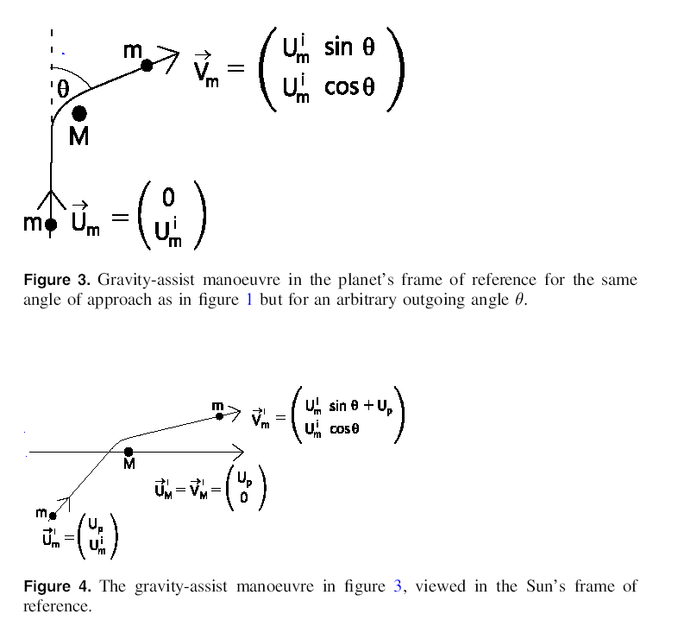
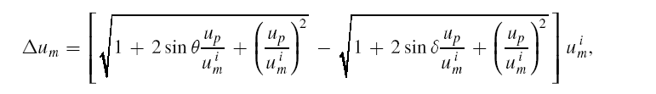
Derivation (speedrun)
- So far so good, but that’s only for a perfect right angle scattering… (in the planet frame)
- Turns out you can actually build this up quite a bit just using trig…
- For an arbitrary outgoing angle Ɵ…
- And for an arbitrary incoming angle δ… (not pictured)
Note: we have so far not made any explicit reference to gravity! Just geometry and conservation of energy. Let’s add the gravity now… (almost there!)
- See P Berg 2023 Eur. J. Phys. 44 025002

Slide 11
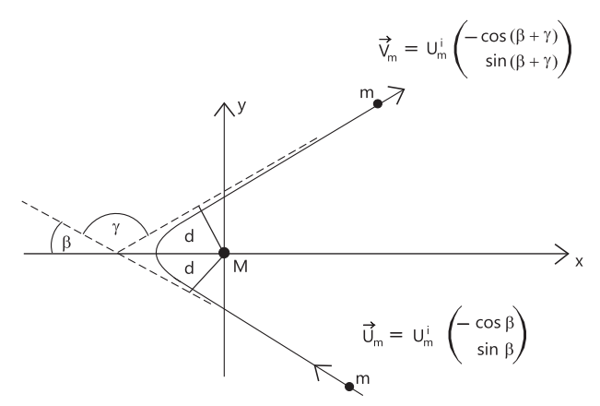
Explicit Gravitational Scattering
- Here’s the situation we want to optimize (finally!)
- Our spacecraft approaches at an initial speed u and initial angle β
- It is then scattered by the scattering angle γ with a final speed v
- We’re ignoring direction of velocity here: all we care about is the change in speed (this is what we want to maximize!)
- The change in velocity due to this maneuver is…

Slide 12
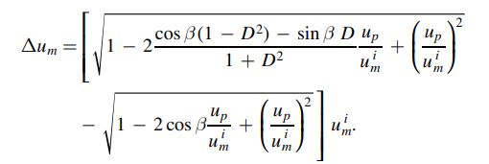

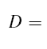
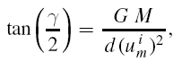
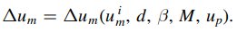
…where
We see that the change in speed is a function of five parameters:
Too many unknowns! But we know the mass of Mars, so we can scratch that one…

Slide 13
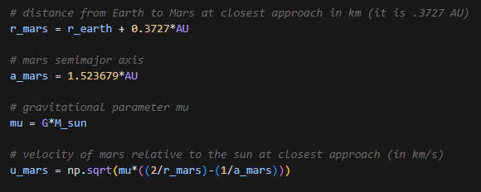
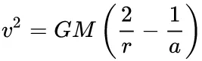
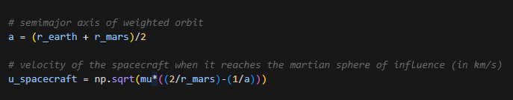
And we can use the vis-viva equation to find the velocity of Mars….
For the initial velocity of the spacecraft, we note that we’re starting from Earth’s orbit and ending up in the sphere of influence of Mars, so we use the same equation…. (a is weighted average)
https://orbital-mechanics.space/orbital-maneuvers/hohmann-transfer.html

Slide 14
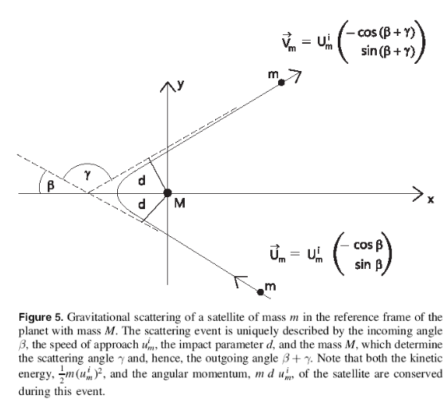
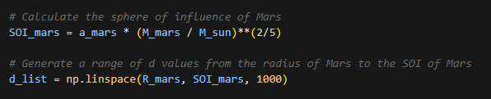
Two parameters left!
- d is tricky….how can we know the impact parameter if we don’t know the trajectory yet?
- ..we can’t! but we can narrow down the possible range….
- Unlike the image to the right, Mars is not a point mass! And if our d is less than the radius of Mars, that’s clearly no good….there’s a lower bound!
- We use Mars’ SOI…since that’s the regime the maneuver takes place in (outside that sphere, we can ‘safely’ ignore Mars’ influence)

Slide 15
Now we have 1000 different possible values of d….
And we’ve reduced the expression for the change in speed to a function of one variable – we simply need to optimize β for each possible value of d…
Which means we have to take this derivative with respect to β…
….or…

Slide 16
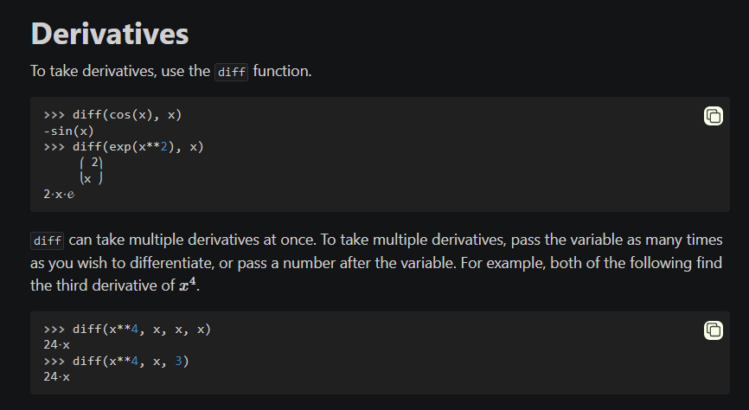
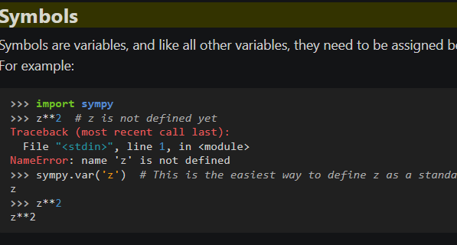
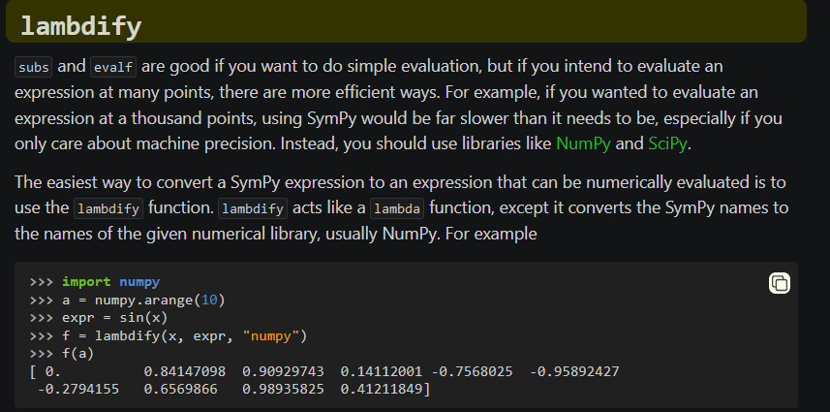
Sympy:
- We made use of the diff function to take the derivative of that function
- To do this, we also needed symbols to create symbolic variables not bound to any particular value (β and the impact parameter d)
- So we set up an expression for delta_u_m using symbols for β and d, and then used diff to find the symbolic derivative
- But that’s only an expression, not a function! So to go back to a function, we used lambdify to convert a symbolic expression to a function that can be numerically evaluated! (similar to lambda functions in vanilla python)

Slide 17
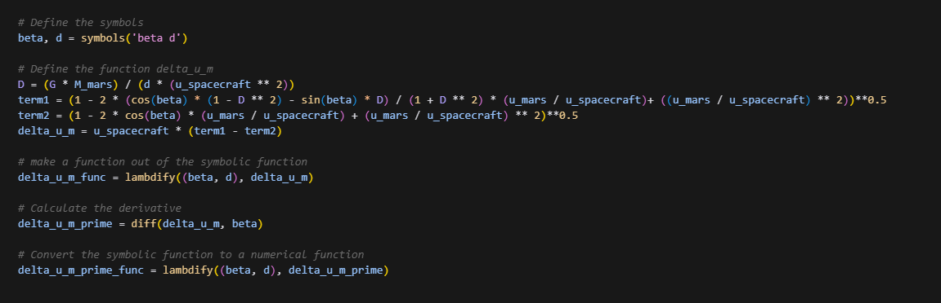

99% of the way there! All that’s left to do now is….

Slide 18
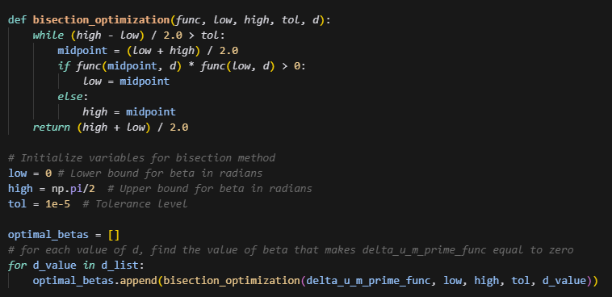
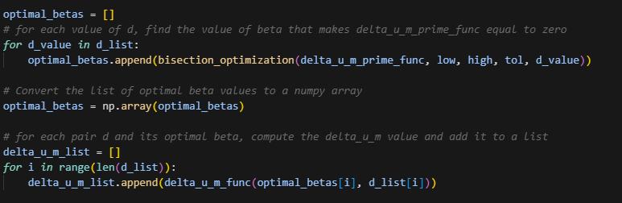
The Actual PHYS481 Part
- In which we used a pretty simple bisection algorithm to find the roots (within a given tolerance)
- We did this for each value of d in the list we made, and then checked our original function for the speed with each pair of d and its corresponding optimal β
- Then we just found the maximum of those values, and that tells us which d and β will result in the greatest increase in speed from the gravitational assist
- The results….

Slide 19
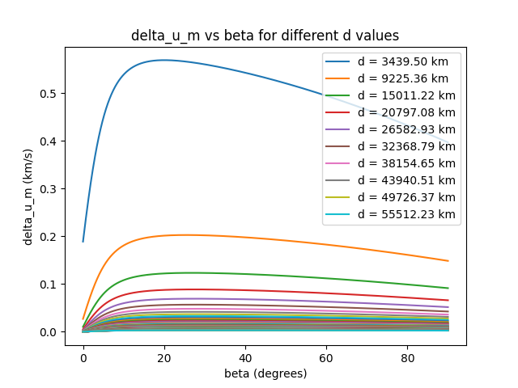

Slide 20
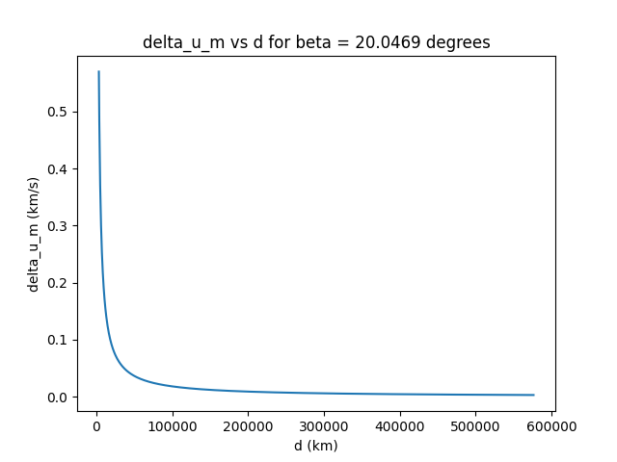

Slide 21
Summary of Assumptions:
- Patched conic (only considering the interaction between our spacecraft and one other body depending on SOI – no 3 body problems, just a series of 2-body problems in different regimes)
- In a planet’s SOI, the planet’s gravity overwhelms the influence from the Sun
- Timescale small enough that we can approximate the motion of a planet over that time as linear
- Also assumed Earth’s orbit is perfectly circular (which is close to true, but is NOT the case for Mars)
- Assumed we timed the trip so we reach Mars at the time of its closest approach to Earth, which is not EXACTLY at its perihelion, but is pretty close (less than 1% error)
- Relativistic correction not needed (maximum speed relative to the Sun is ~27km/s which is ≈0.00009c) – less than 0.001% error

Slide 22
Conclusion:
- There’s a lot of momentum out there in the solar system…take advantage!
- Instead of paying for extra propellant, just steal some momentum from the planets. It’s cheaper!
- …and cheaper is better when applying for funding!

